Slide 1

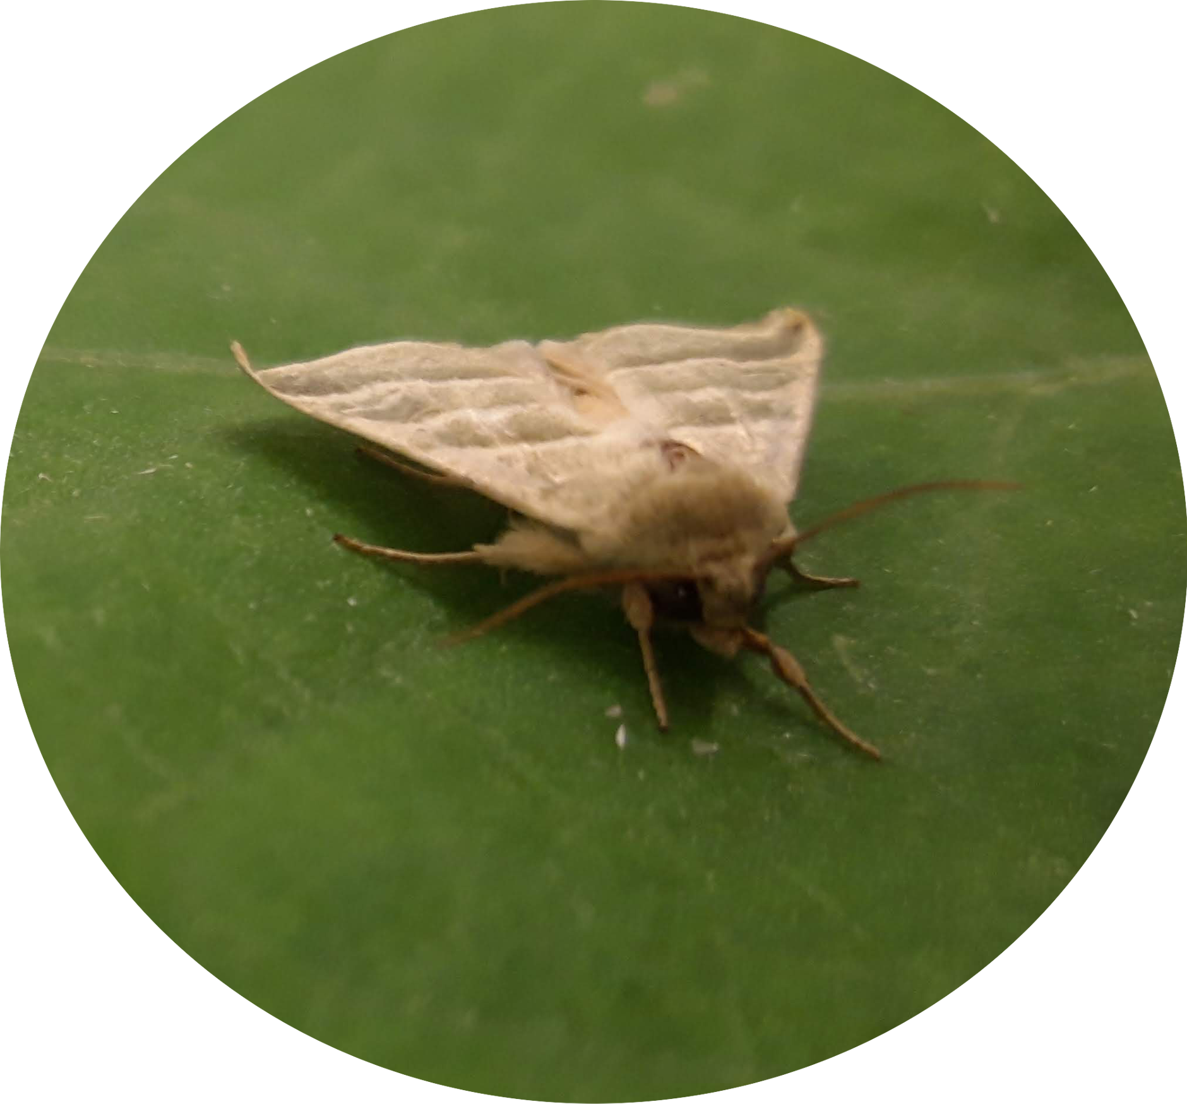


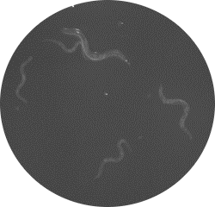
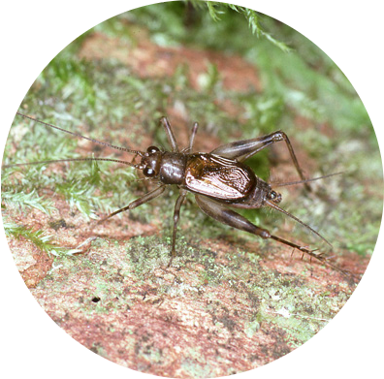
QTL workshop
23 July 2021
Thomas Blankers
t.blankers<at>uva.nl

Slide 2
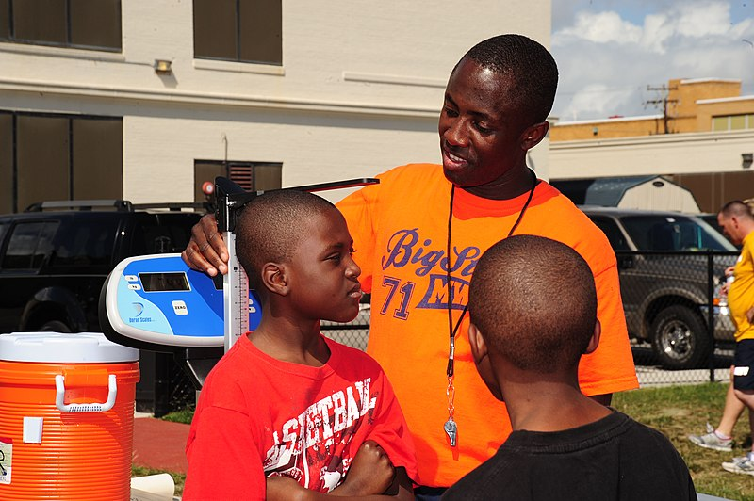
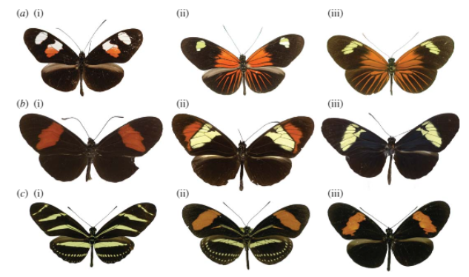
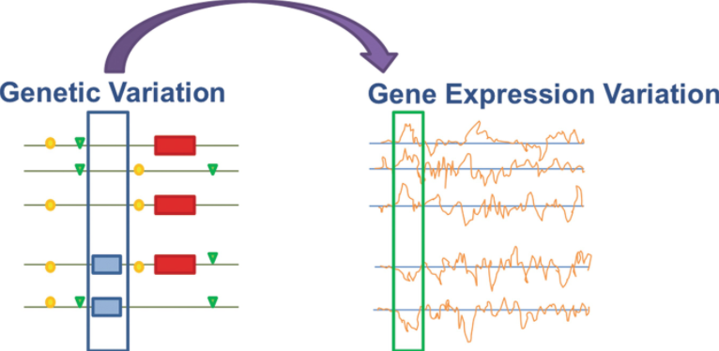
What is QTL analysis
Identification of the genetic loci that underlie differences in a quantitative trait between two “parental” lines
Wikipedia
Jiggins et al. Phil. Trans. Roy Soc. 2008
Nodzak. eQTL Analysis. 2019

Slide 3
Why QTL analysis?
Genetic Architecture
Large versus small effect loci
Distribution of loci across the genome
Interactions among loci

Slide 4
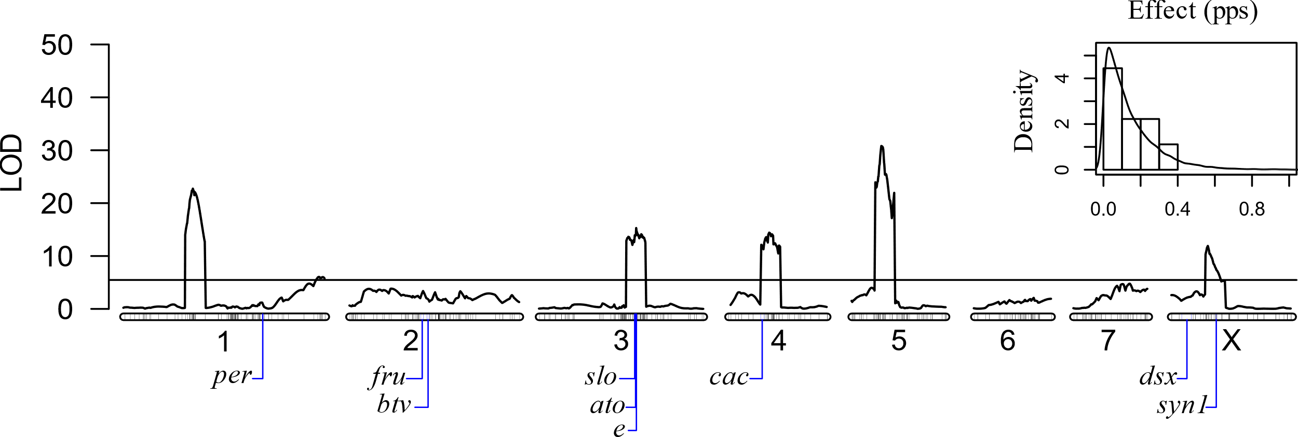
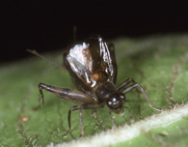
Why QTL analysis?
Genetic Architecture
Large versus small effect loci
Distribution of loci across the genome
Interactions among loci
Candidate Genes

Slide 5
What do we need?
Organisms that can be reared in the lab, parental lines that can interbreed under lab conditions
Quantitative, heritable phenotypes that have diverged between the parental lines
Lower heritability means lower QTL effect size means higher sample size needed to detect QTL
Less phenotypic divergence means lower QTL effect size means higher sample size needed to detect QTL
Genotypic markers (e.g. SNPs)
Recombination
With achiasmatic meiosis (e.g. in Drosophila males or Lepidopteran females) QTL can only be detected at the level of chromosomes

Slide 6
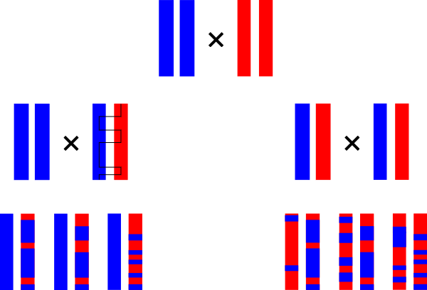
Cross design

Slide 7

Cross design

Slide 8

Cross design

Slide 9

Cross design
Backcross
F2 cross

Slide 10
Cross design
Backcross
F2 cross

Slide 11
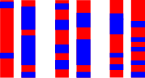
Linkage map construction
Frequency of recombination events among genetic markers in the mapping give measure of genetic distance:
position in cM

Slide 12
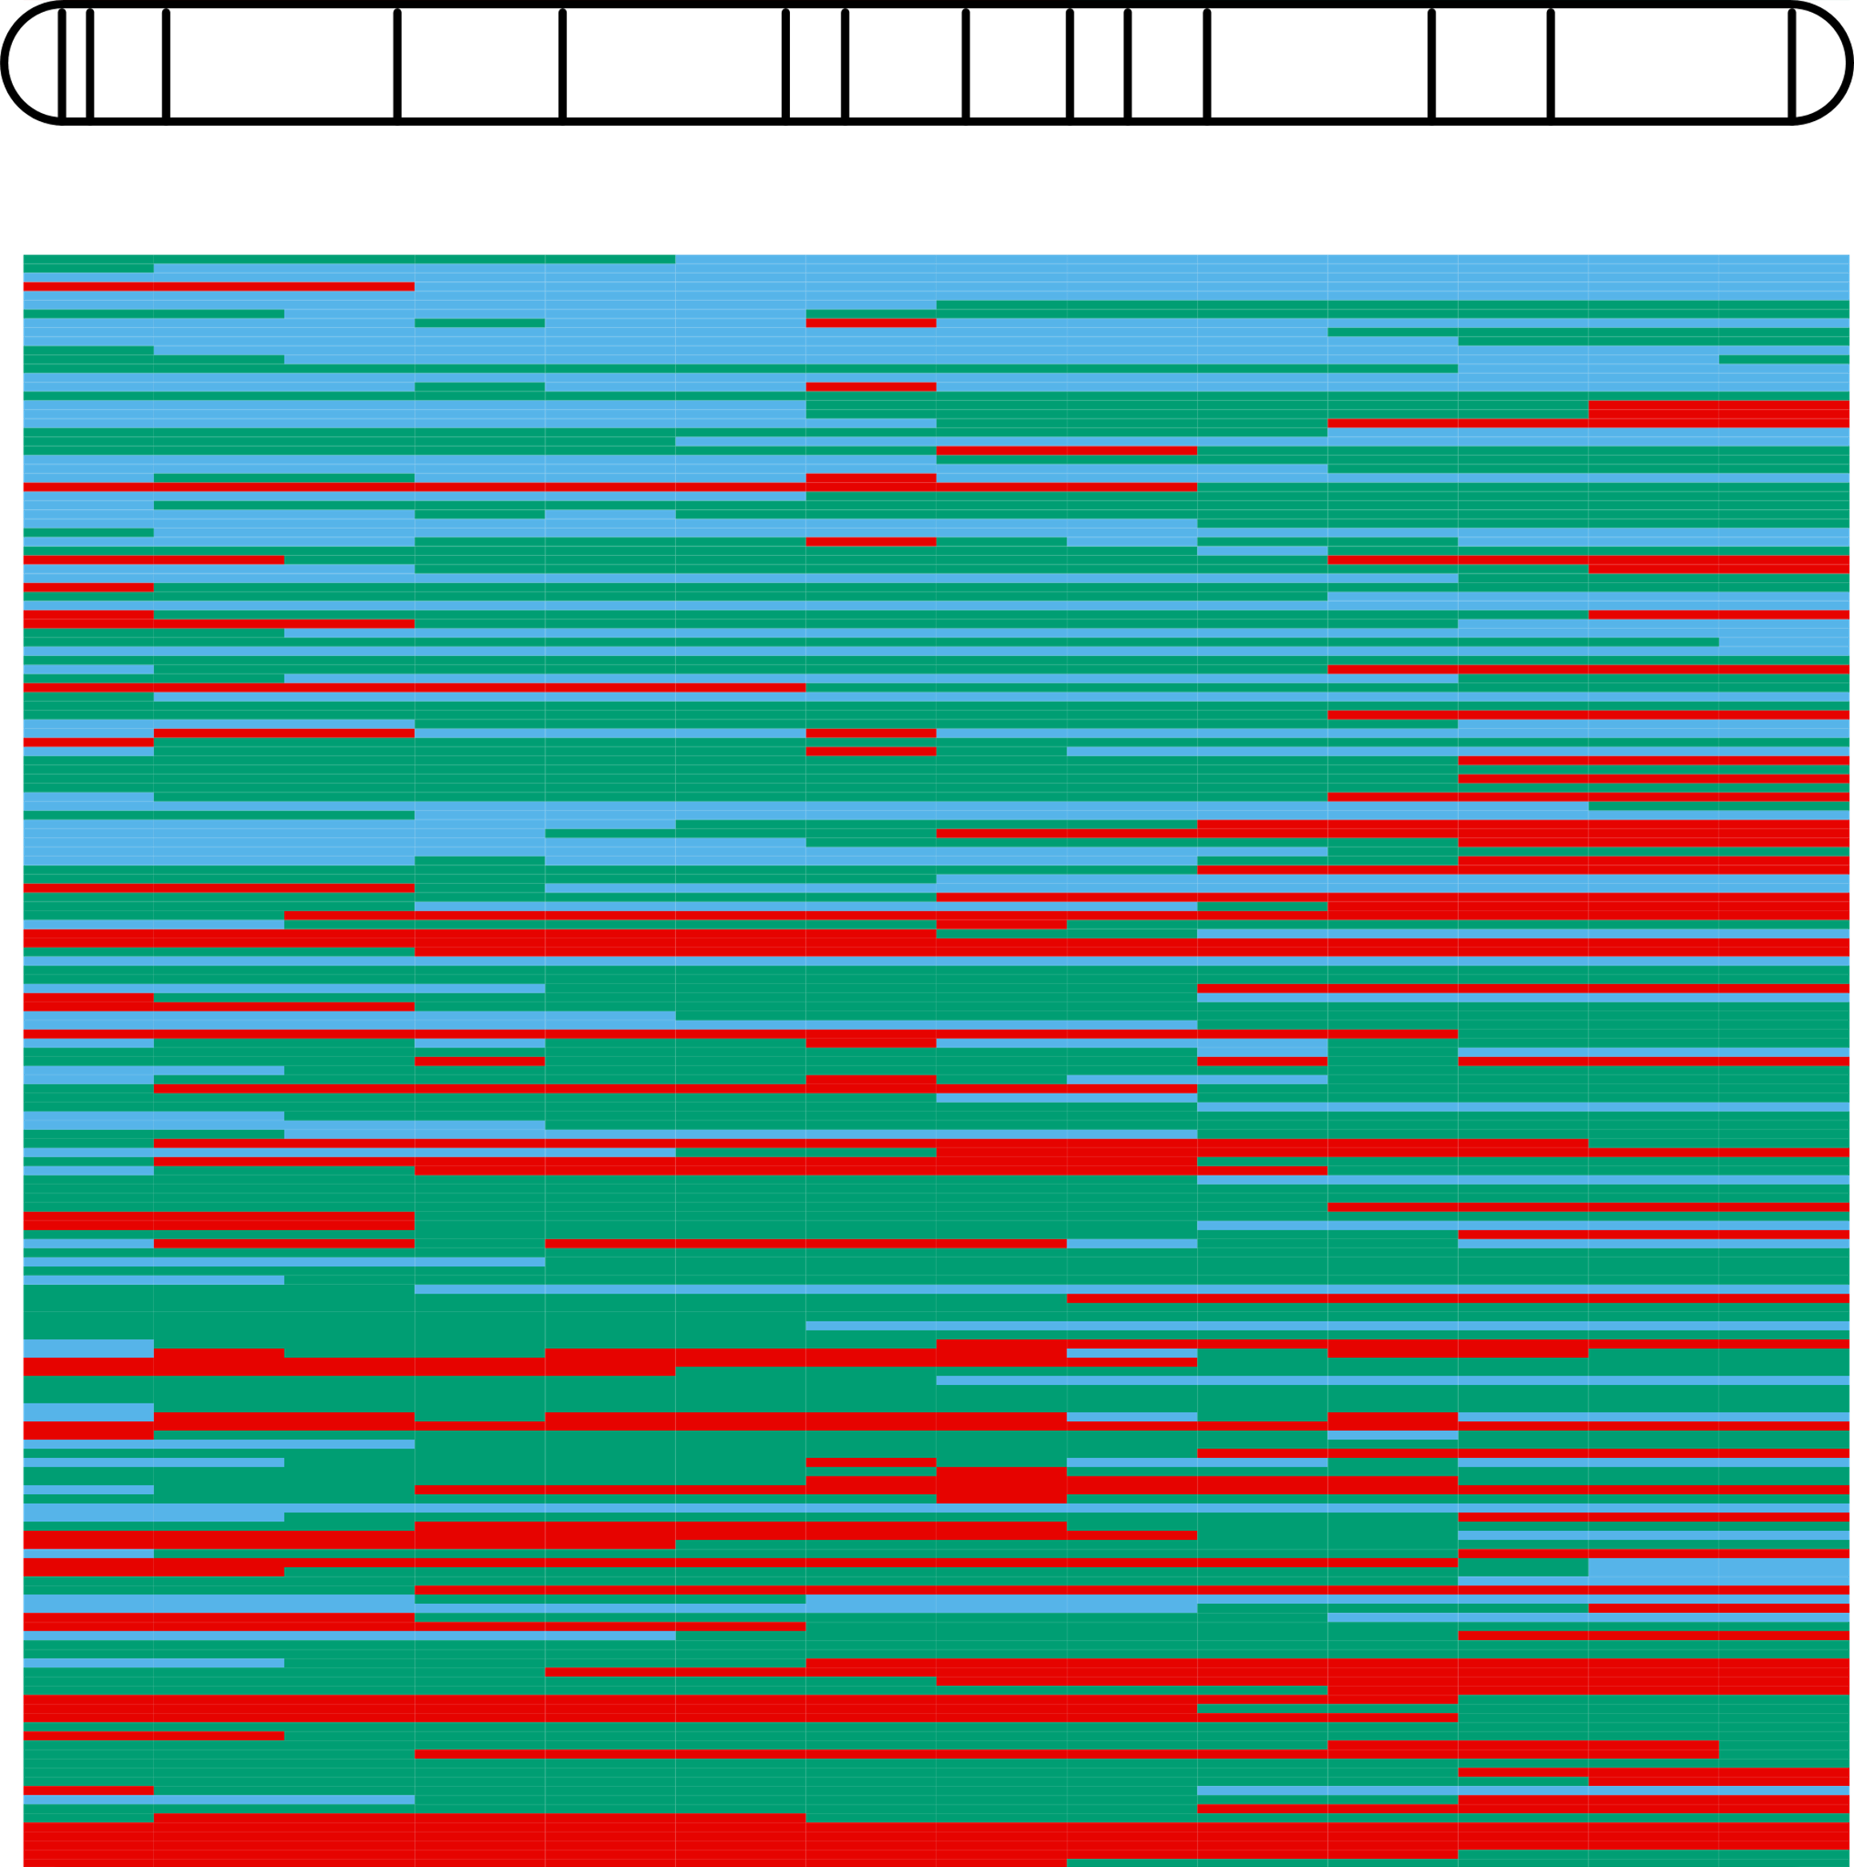


Matching genotypes and phenotypes
linkage group
Phenotype
Genotype
AA
slow
AB
BB
fast
Individual genotypes per marker

Slide 13
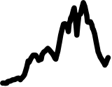
QTL mapping
genotypes
phenotypes
AA
slow
AB
BB
fast
log of odds (LOD)
Association between genotypic and phenotypic segregation give measure of correlation strength
position in cM

Slide 14
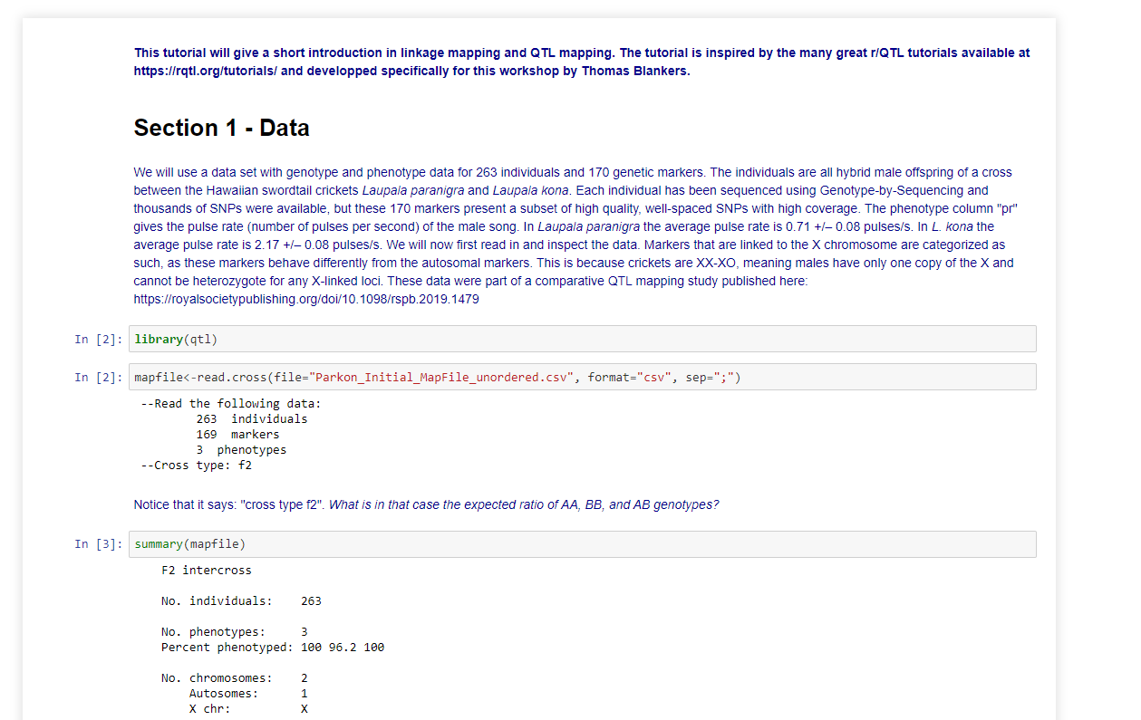
Tutorial
You’ll find the tutorial notebook, associated files and this presentation at
https://github.com/thomasblankers/QTLworkshop

